Slide 1
Solidarity and Politeness
Charalambos Themistocleous
www.charalambosthemistocleous.com
themistocleous@gmail.com

Slide 2
Solidarity and Politeness

Slide 3
Politeness
Face wants
Negative face
Positive face
Social distance
Negative politeness strategies
Positive politeness strategies
Power
Cost of imposition
Inherently face-threatening acts
Speech acts
Bald, on record
Sociolinguistic competence
Grammatical competence
Pragmatic competence
Contrastive analysis
Individualistic
Collectivist
Wakimae

Slide 4
Intuitive notions of politeness
List five things that you consider polite and five things you consider impolite. Do you all agree in the same things?

Slide 5
Politeness
The actions taken by competent speakers in a community in order to attend to possible social or interpersonal disturbance.

Slide 6
Euphemisms
Think of euphemisms you use in order to avoid being impolite.

Slide 7
Politeness Theory
tu–vous (T/V) distinction in French, where grammatically there is a ‘singular you’ tu (T) and a ‘plural you’ vous (V) but usage requires that you use vous with individuals on certain occasions.
The T form is sometimes described as the ‘familiar’ form and the V form as the ‘polite’ one.

Slide 8
Other languages with a similar T/V distinction are Latin (tu/vos), Russian (ty/vy), Italian (tu/Lei), German (du/Sie), Swedish (du/ni), and Greek (esi/esis).
English, itself, once had such a distinction, the thou/you distinction.

Slide 9
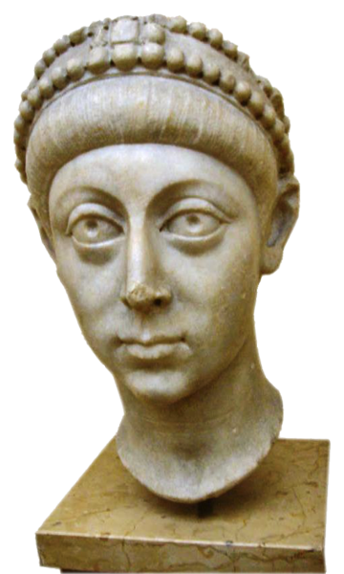
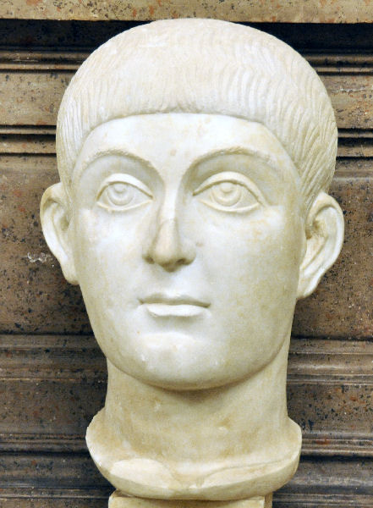
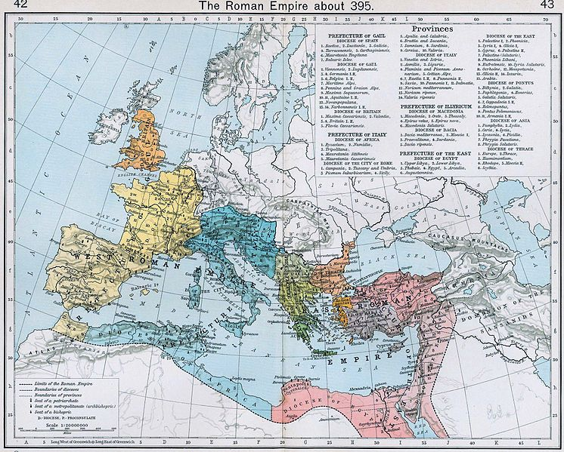
The origins of tu/vous
Honorius
Arcadius

Slide 10
Theories of politeness
Linguists differ in the way they analyze politeness.
Some emphasize the speaker, the addressee (or both), and the emphasis they give to accounting for behaviour that would be considered polite or behaviour that would be considered impolite.

Slide 11
More recently work by Japanese, Chinese, African and Middle Eastern scholars has begun to make more of an impact on the field of politeness studies.
These researchers have emphasised the empirical and theoretical importance of seeing politeness and impoliteness as acts which involve consideration of the addressee’s wants and desires as well as the speaker’s own, and acts that involve consideration of the demands of the larger social group in which both the speaker and addressee have grown up and been socialized.

Slide 12
Brown and Levinson (1987)
Penelope Brown and Steven Levinson (1987) propose that it is important to realise that both deferential response and a joking response can be analysed as forms of politeness.
Most people associate politeness just with ways of speaking that avoid causing offence by showing deference to another person.

Slide 13
But Brown and Levinson point out that in any speech community in some contexts deference would be inappropriate.
Instead comments that orient to ingroup membership may be hat oil the wheels of an interaction and avoid causing offence.
Deference may sound peculiar or interpreted as snobbish and perhaps impolite and rude.

Slide 14
Brown and Levinson’s goal was to provide a framework for analysing politeness that could accommodate considerations like those mentioned.
Their goal was also to provide a basis for discussing similarities and differences between cultures in how politeness works.

Slide 15
Face and Politeness
Someone “Loses face” when he or she does not perform as expected in a certain occasion, if he or she does something embarrassing.
Someone “Saves face” when after doing something embarrassing says something lets say joke to minimize the seriousness of what he or she did.

Slide 16
B&L propose that we want to guard our face against possible damage when we interact with others.
The reason that we are polite is that we concerned with maintaining two distinct kinds of face:
Negative face: is the want of every competent adult member of a community that their actions be unimpeded by others.
Positive face: is the want of every member that their wants be desirable to at least some others.

Slide 17
Look at the qualification that face wants are something competent adults in a community have. In other words we have to learn or acquire negative and positive face wants.

Slide 18
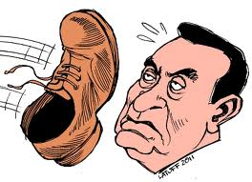
What is and is not considered polite varies from place to place!!!
A competent member of Arab society knows that it is terribly rude to show the soles of your feet to someone.

Slide 19
Social distance and politeness. Societies that pay attention to negative face want to keep the social distance.
In Japan students would usually address a university professor by his or her last name and then they will add the honorific suffix –sensei (meaning ‘teacher’). By emphasizing the social distance between the student and the professor, it attends to both parties’ negative face wants.

Slide 20
The situation in Germany is analogous:
There, students and more junior faculty members typically address university professors by their full professional titles.
This means that if you are addressing a full professor who has a Ph.D. and who has also been awarded a honorary degree from another university, you are expected to use all those titles when you greet them:
Guten Tag, Frau Professor Doktor Doktor Nussbaum
In Greece and in Cyprus?

Slide 21
The specific linguistic and non linguistic strategies that display attention to either the speaker’s or the addressee’s face wants can therefore be referred to as ‘positive’ and ‘negative’ politeness strategies.
Even a brief exchange such as a greeting can illustrate some of the different linguistic strategies used to express the two kinds of politeness.

Slide 22
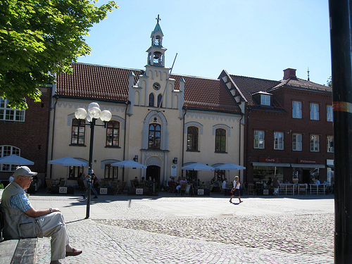
For example, suppose you are passing by the outdoor tables of a coffee shop and you recognize an old friend who haven’t seen for some time. You might call out to them using a nickname:
Mouse! I haven’t seen you in years. You look terrific! What are you up to?

Slide 23
The use of ingroup code (here, a nickname Mouse) showing attention to the addressee’s interests (what are you up to) and exaggerating the speaker’s interest or approval (you look terrific) are all strategies that attend to the addressee’s positive face wants.

Slide 24
Other greetings attend more to the hearer’s negative face wants.
Excuse me, Dr Michaels, I’m sorry but could I just interrupt you for one moment?
There is a deferential for of address (Dr Michaels), an apology (Excuse me; I’m sorry) and an attempt to minimize the request (just; one moment). These are negative politeness strategies because they attend to the addresse’s negative face wants, that is to their desire to be left alone to pursue their own actions or interests unimpeded.

Slide 25
Choosing politeness strategies
Brown and Levinson identify three specific factors:
Power
Distance
Cost of imposition.

Slide 26
Power
Power is a vertical relationship between speaker and hearer. Along with distance and cost of imposition, power determines how much and what kind of redressive action the speaker might take with a face-threatening act.

Slide 27
Cost of imposition
a scalar measure of how serious a face threatening act is in a particular society, and given the power and distance difference between speaker and hearer.
How would you rank the cost of imposition involved in asking someone to:
Give you money,
To check your flat or while you are on holiday?
To feed your pets and water the plants?
To answer and deal with any mail?

Slide 28
Face-threatening acts (FTAs).
face-threatening acts (FTAs).
That is if you decide to undertake one of these conversational events, somebody’s positive or negative face wants will be threatened (sometimes it will be the speaker’s and sometimes it will be the hearer’s).

Slide 29
Speech Acts
B. Austin (1962) Speech Acts
Locutionary act: you are saying something,
Illocutionary act: you are doing something.
Perlocutionary act: the effect of what you are doing (such as persuading, convincing, scaring, enlightening, inspiring, or otherwise getting someone to do or realize something, whether intended or not).

Slide 30
A compliment can have a serious impact on the addresee’s desire to have their actions proceed unimpeded.
In some societies, there is an obligation or strong expectation to offer the speaker something they have complimented.

Slide 31
Whose face is threatened | Negative face | Positive face
Addressee | Orders or requests Threats or warnings Compliments, or expressions of envy | Disapproval or criticisms Disagreements Bringing bad news about H, or good news about S. Non-cooperation, like interrupting.
Speaker | Accepting an apology Saying thank ypou | Making an apology Showing lack of (physical or emotional control)

Slide 32
Making an apology is a threat to the speaker’s positive face because it involves going on record with the fact that we have done something that is socially frowned on.
If you are on record as having acted stupidly, unkindly or tastelessly, then other people are unlikely to identify with you

Slide 33
Bald, on record
The term refers to an inherently face-threatening act made without any softening through positive or negative politeness strategies. Notice they do not call this impolite.

Slide 34
